Slide 1
Metagenomics data

Slide 2
Environmental data collection
Collecting environmental factors associated with soil samples
1. Including :
Annual Precipitation;
Annual average temperature
Soil sand/silt/clay content
Soil C and N (or C/N) content
Elevation
Metagenomics
data
Environmental
data
2. Source :
Relative publication
Research official website
Things to record:
  Samples in JGI
Soil samples
3. Notes:
Record the units
Keep track of the sources
Sample-level > site-level

Slide 3

Steps
1. go to jgi for metagenomics data.
https://img.jgi.doe.gov/
2. Find metagenomics data by study id

Slide 4
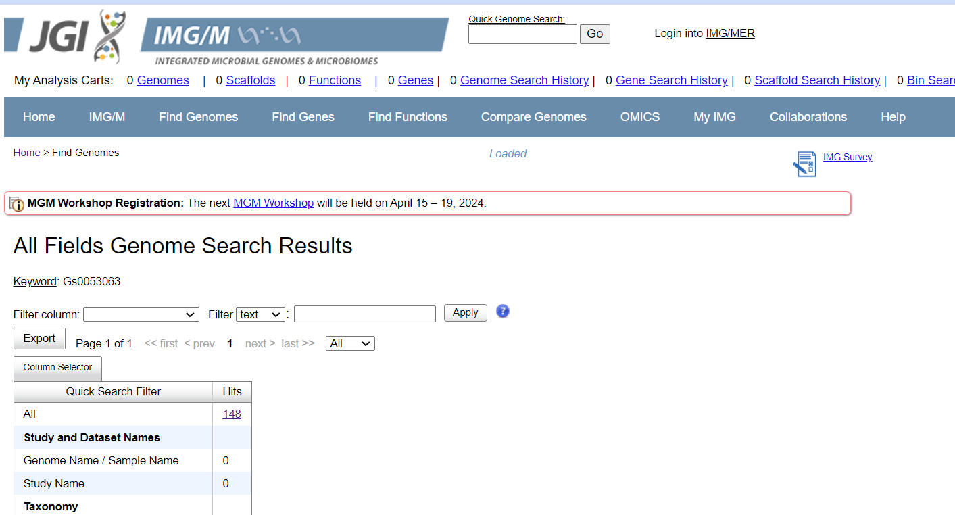
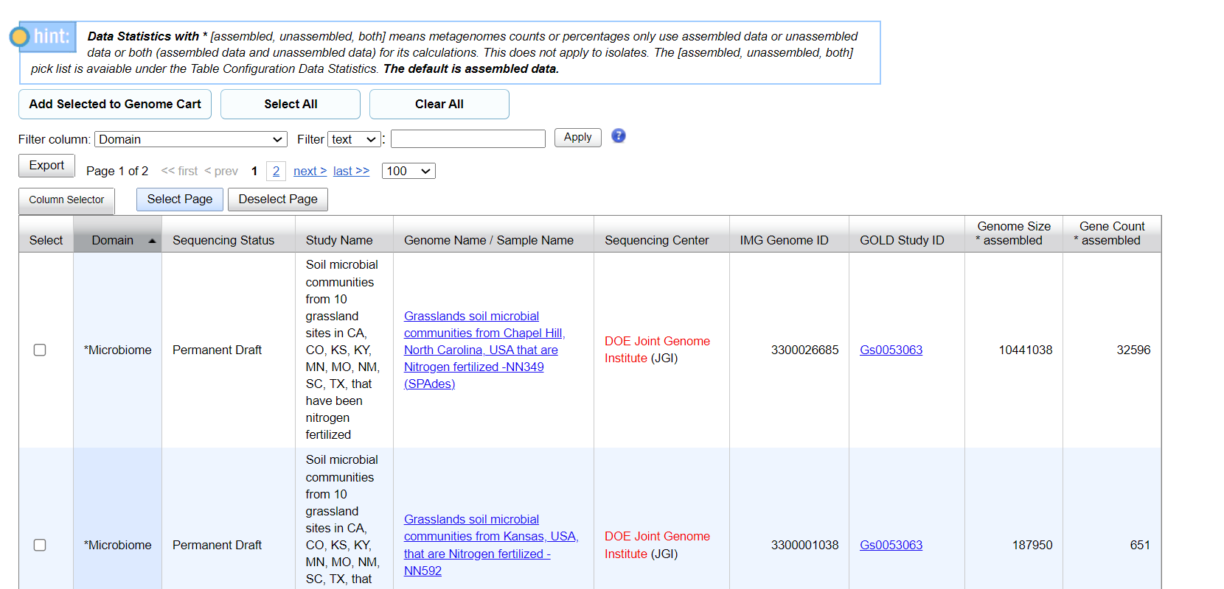
Steps
3. check the metagenomics data

Slide 5
Steps
4. search everywhere to find the environmental data associated with the corresponding metagenomics
  environmental data includes: Annual Precipitation; Annual average temperature; Soil sand/silt/clay content; Soil C and N (or C/N) content; Elevation
  “associated with” means the state or value of those variables when the samples are collected.
    1. time
    2. location
    3. identifier
  Source of the environmental data includes academic paper using that metagenomic data; official research website etc.
  Keep record of the data collections, including sources, environmental data even you only find part of it.

